Slide 1

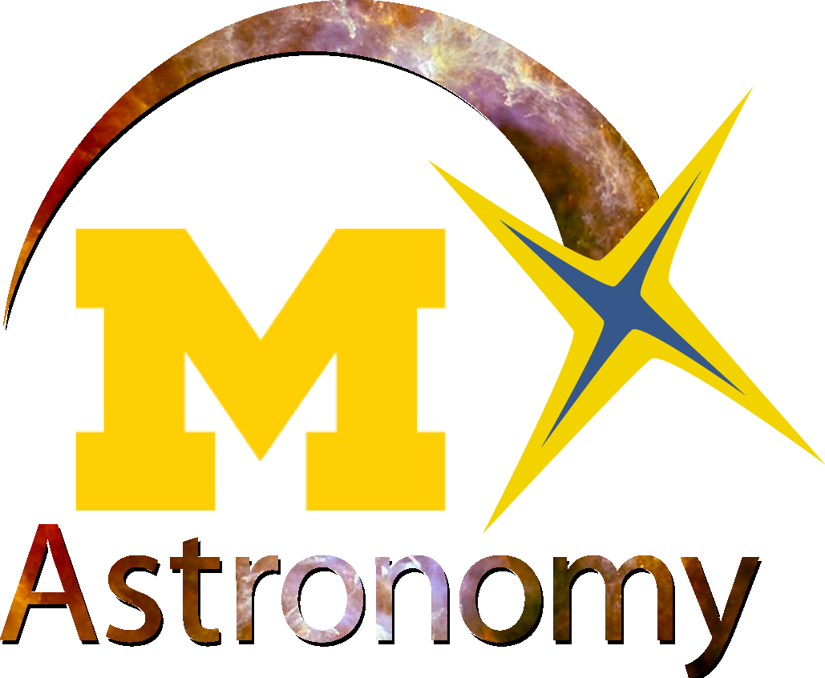
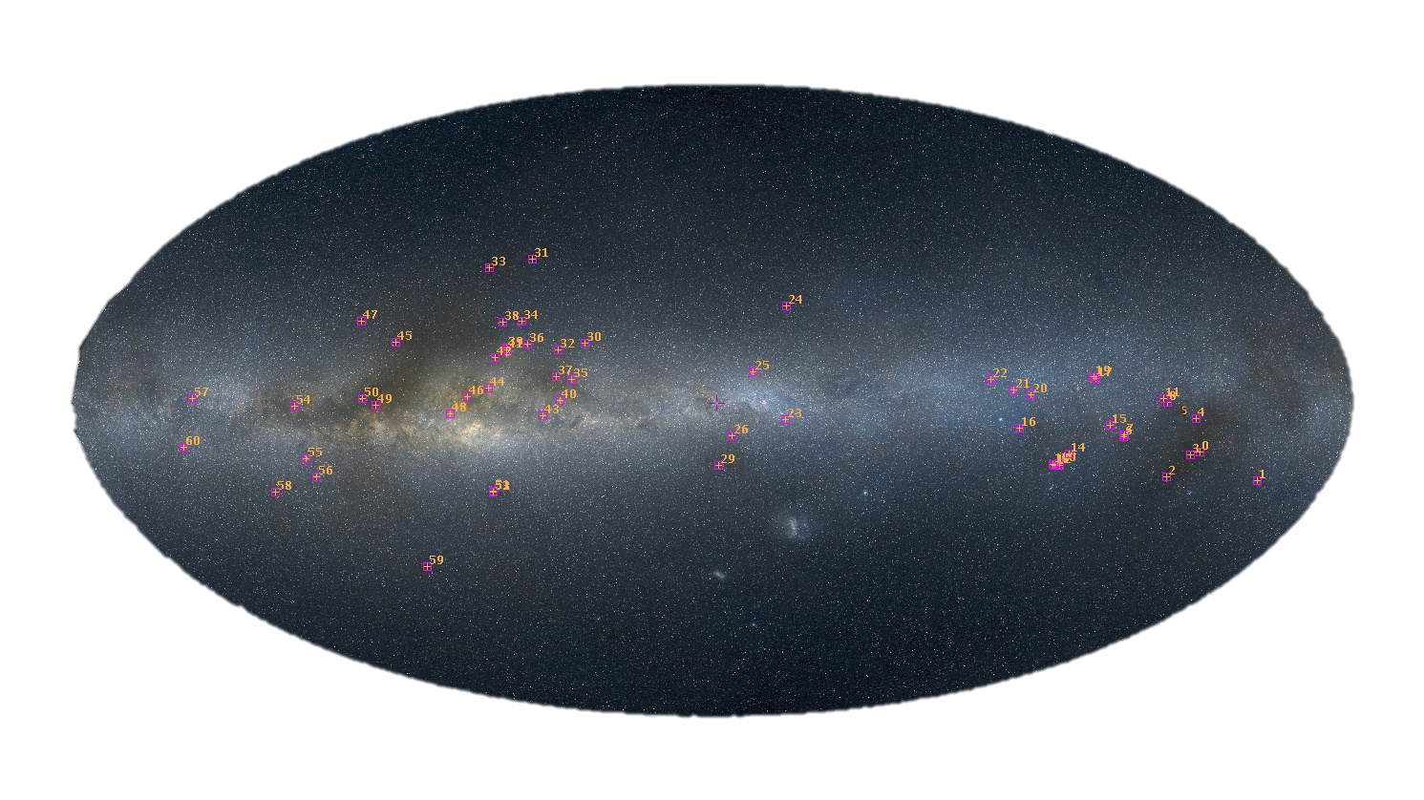
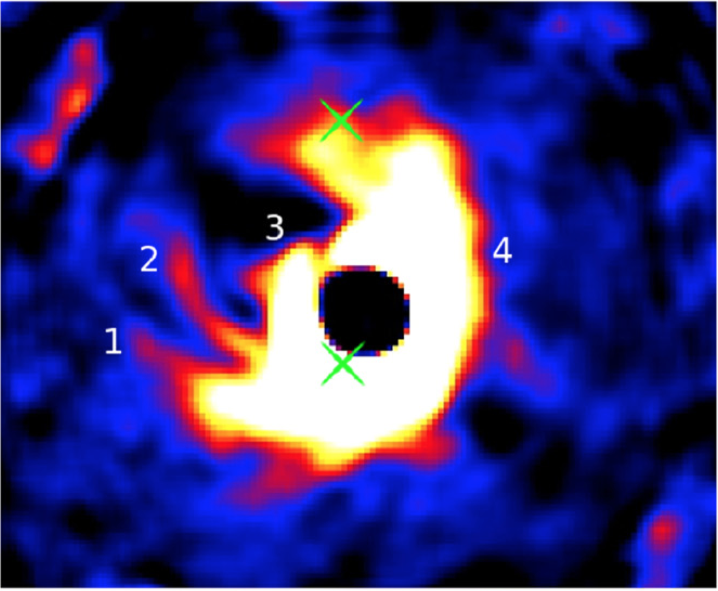
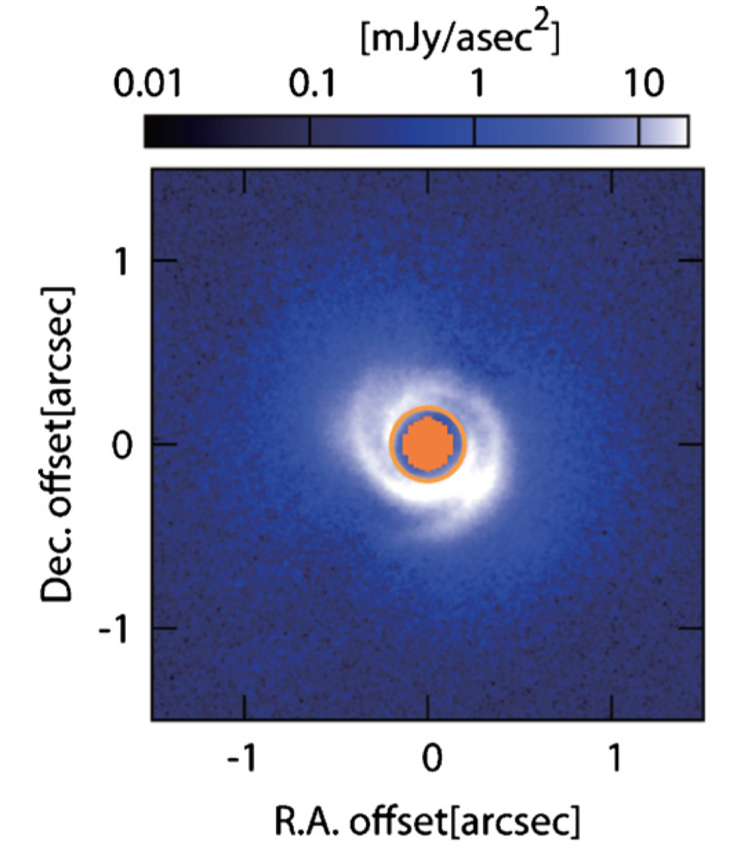
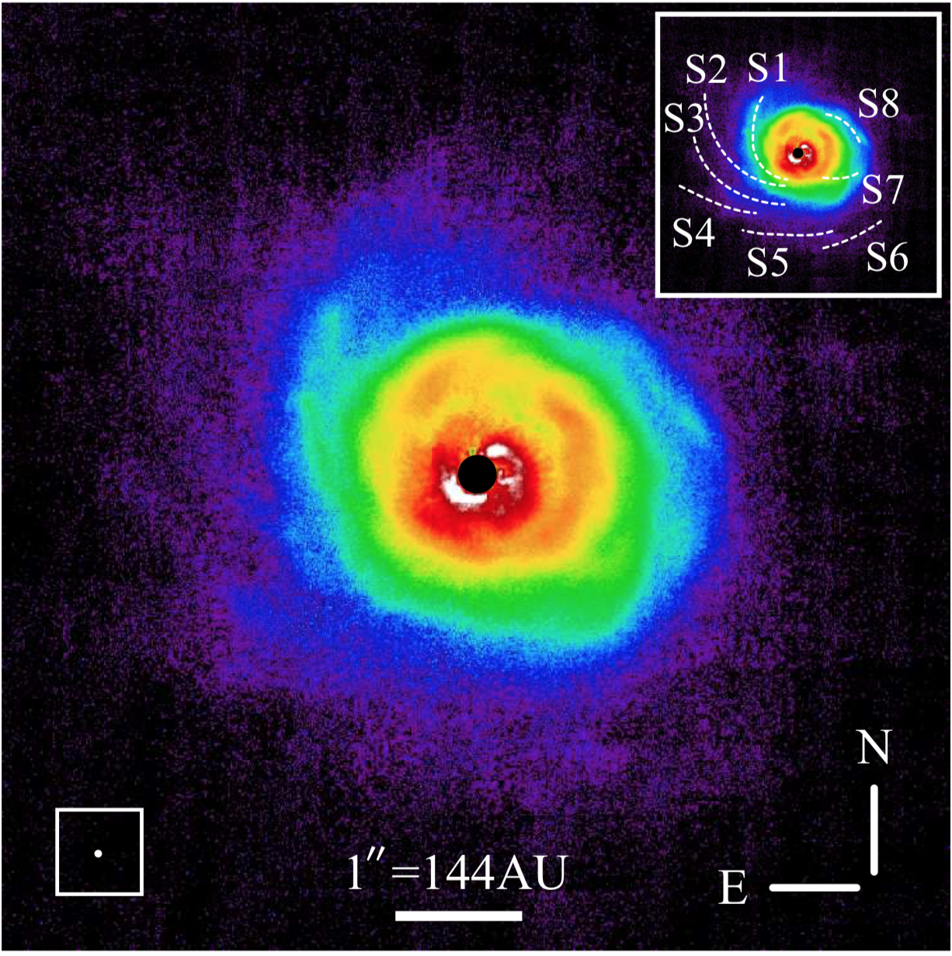
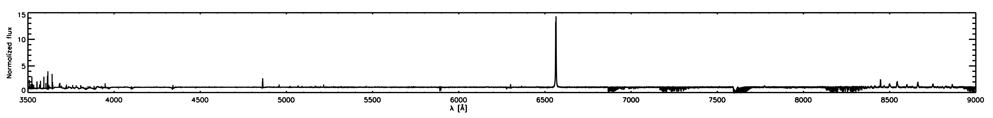
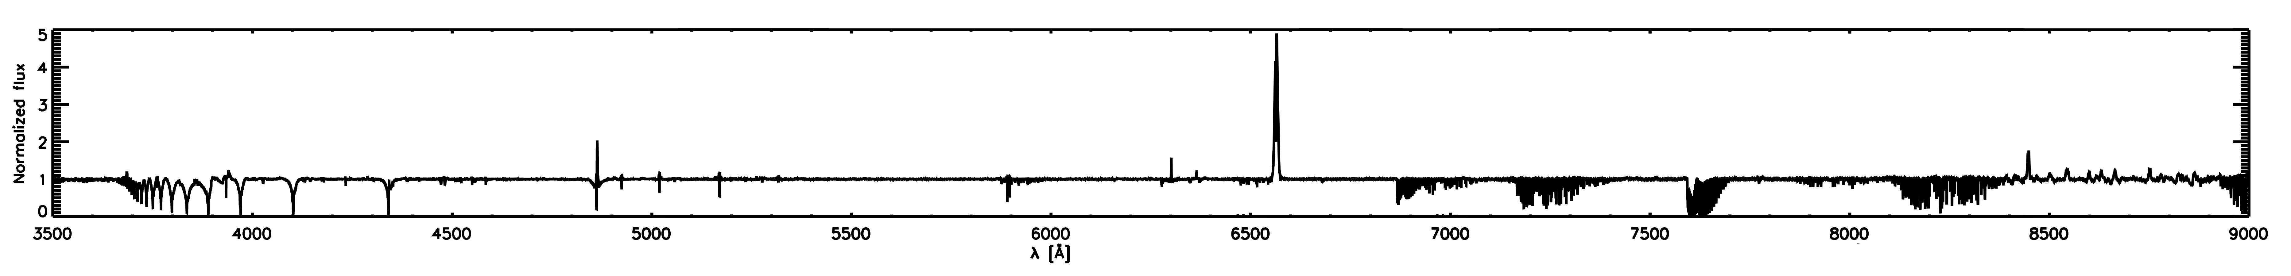
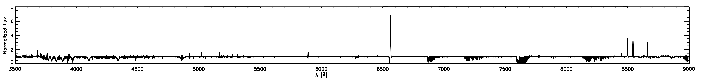
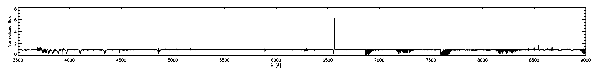

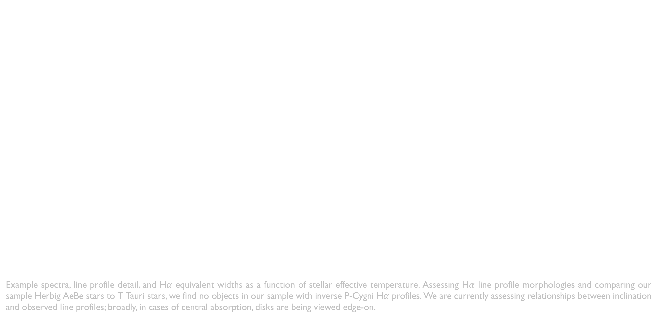
A High-Resolution Optical Spectroscopic Survey of Herbig AeBe Stars
A. N. Aarnio (University of North Carolina Greensboro), J. D. Monnier (University of Michigan)
Abstract: We present an atlas of high-resolution optical spectra of Herbig AeBe stars, pre-main sequence objects bridging the gap between high- and low-mass star formation. Our data are from the Magellan Inamori Kyocera Echelle (MIKE) double echelle spectrograph and span a range of ~3200-9000Å. We analyze and categorize spectral line morphologies and comment on their relationship with stellar parameters derived from the spectra and the literature. A preliminary discussion of coordinated interferometric measurements, part of a broader Michigan Young Stellar Object program, is also presented.
Our survey targets, plotted over optical all-sky data.
Our Survey: Our sample includes targets designated as young stellar objects, Herbig AeBe stars, and infrared excess stars, and prioritizes targets with interferometric data available to constrain inclination and inner disk edge location. Over a many-year coordinated campaign, we observed ~60 Herbig AeBe, intermediate-mass T Tauri, and T Tauri stars (positions mapped in middle panel) with optical (this work) and near-infrared spectroscopy (Reiter et al. 2018). This spectral type coverage offers continuity across a range of masses of forming stars, allowing for comparison of systems at similar evolutionary state.
(Left) H-R diagram for the sample. Orange diamonds: Gaia distances (Bailer-Jones et al. 2018) and G magnitudes used to calculate M_{bol,} T_{eff} from Gaia DR2 (Gaia Collaboration, 2018). Purple diamonds: M_{bol} as above, T_{eff} derived from literature spectral types and pre-main sequence temperature/spectral type scale of Kenyon & Hartmann (1995). PMS tracks of Siess et al. (2000), from 1-7 M⦿. Ongoing modeling of spectra aims to resolve discrepancies in T_{eff}; our fits to synthetic spectra also trend to hotter temperatures. (Right, top) Histogram of distances to our sample stars. (Right, bottom) Projected rotational velocity as a function of stellar effective temperature.
Data were reduced using the MIKE IDL pipeline (Bernstein, Burles, & Prochaska, 2015) and assorted post-pipeline processing routines written by the authors. Blaze and continuum removal were performed on 2D spectra, and orders were joined to form one normalized spectrum across the entire MIKE wavelength range. Equivalent widths were measured for an assortment of lines diagnostic of accretion and circumstellar processes. Where necessary, spectral lines were fitted with multiple Gaussian components (see Aarnio et al. 2017) to separate emission and absorption (the latter likely due to winds).
Infrared color-color diagram for our sample (2MASS and WISE; Cutri et al. 2003, 2013), with directly imaged reference objects to demonstrate kinds of disks observed around objects in various locations of the diagram.
Currie et al. (2015)
HD 100546
Muto et al. (2012)
HD 135344B
AB Aur
Hashimoto et al. (2011)
Example spectra, line profile detail, and H$α$ equivalent widths as a function of stellar effective temperature. Assessing H$α$ line profile morphologies and comparing our sample Herbig AeBe stars to T Tauri stars, we find no objects in our sample with inverse P-Cygni H$α$ profiles. We are currently assessing relationships between inclination and observed line profiles; broadly, in cases of central absorption, disks are being viewed edge-on.
Future work
Spectra will be published in 2019 and made available online. Additional data products to be published will include:
Equivalent width tables
Homogeneously derived stellar parameters: T_{eff}, log(g), metallicity, v*sin(i), radial velocity
Spectral energy distributions
Future publications will focus on radiative transfer modeling to reproduce the observed line profiles and observed spectral energy distributions.
Acknowledgments
The authors acknowledge support of NASA Origins grant NNX09AB87G and NSF AAG F034342.
Accessible .pptx
Background image credit: NASA, ESA, the Hubble Heritage Team (STScI/AURA), A. Nota (ESA/STScI), and the Westerlund 2 Science Team

